Slide 1
AUTOMATING DISK FORENSICS
BY:
KANCHI CHITALIYA
ADITYA KELKAR

Slide 2
WHAT IT DOES?
HELPS TO AUTOMATE DISC FORENSICS FOR REDHAT AND DEBIAN SYSTEM
FINDS OUT SOME BASIC INFORMATION
USES PYTHON SCRIPT

Slide 3
HOW TO USE?
USES PYTHON MODULE SUBPROCESS TO RUN SYSTEM COMMANDS
USES FLASK TO DISPLAY THE INFORMATION ON WEBPAGE

Slide 4
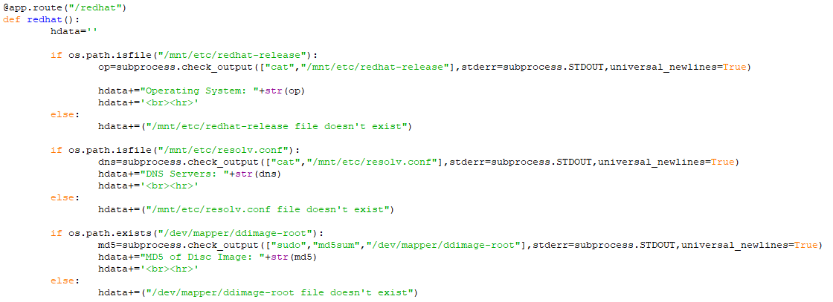
SPECIFIC CODE FOR REDHAT

Slide 5
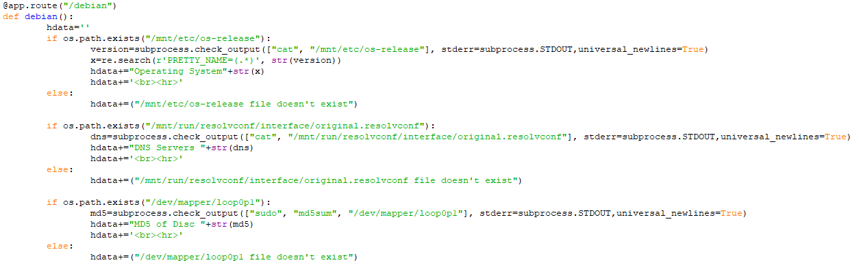
SPECIFIC CODE FOR DEBIAN

Slide 6
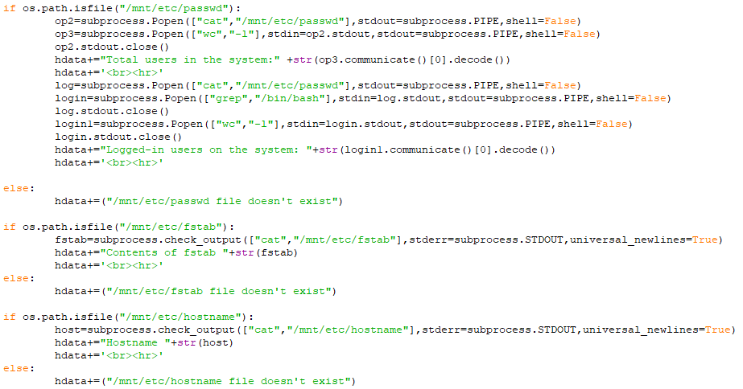
COMMON PART OF DISK FORENSICS CODE

Slide 7
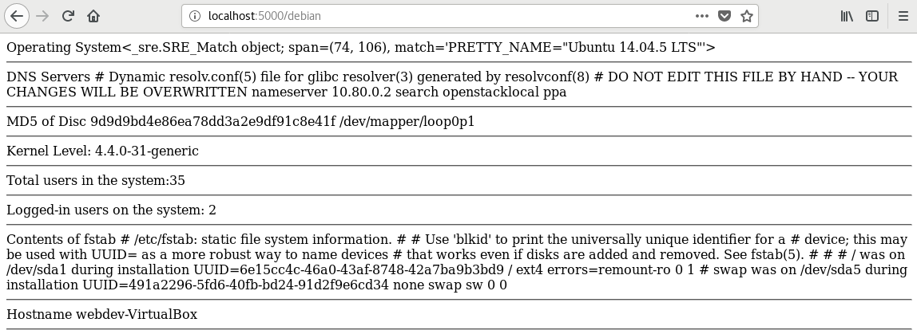
DEBIAN SYSTEM

Slide 8
THANK YOU

